Slide 1
My Life My Choices
WELCOME!
Notes:
For training on facilitating this activity, please contact the Education Manager at Money Fit by DRS, Inc., 208-286-3283 or Education@MoneyFit.org
Download the Classroom Teacher Packet (PDF files of the student cash flow register, the teacher instructions, and a printable copy of the priorities cards)
This course is available to complete online for free, 24/7 at https://moneyfit.org/my-life-my-choices
Pass out the Bags of Priorities before beginning. Ask the students NOT to open them yet.
***See the Activity Directions for more details and for basic suggestions for each screen, particularly for those without notes. ***

Slide 2

My Life My Choices
Financial Choices & Consequences during your First Month away from HOME
A budgeting activity by Money Fit by DRS, Inc.
Notes:
Set the stage for the activity:
Students have time traveled into the future to the year they turn 18 or 19.
They have graduated from high school (congratulations! That was easier than you expected)
While acknowledging that not everyone wants to or should get a 4-year degree after high school, for the purposes of this activity, everyone is in college out-of-state.
There are no parents, friends or family living nearby or helping you with your budget. You are independent and liberated. You may choose:
What to eat (or not eat)
When to go to bed and when to wake up
Whether or not to put your laundry in drawers or on the phone
Students have worked for several summers and made enough money to pay for tuition and books for the first year of school.
Students have arrived at school with about $1,000 left over after paying tuition and books
Students will work part-time while in school. Though it’s not much, it will be much more than the average college student earns.
With regard to the various scenarios, if you, as the facilitator/teacher, have any personal stories that relate to the topics, especially if they are funny or uncommon (unbelievable), you might consider sharing.

Slide 3
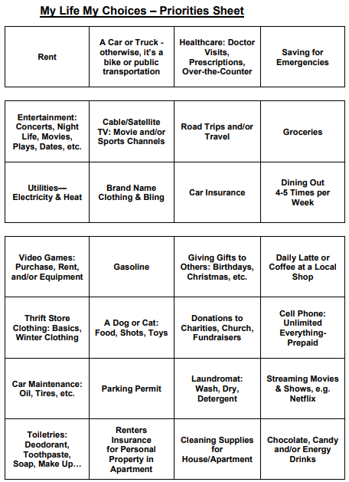
The Priorities Sheet
Choose your priorities
Circle them
Notes:
Briefly discuss the importance of financial priorities (e.g. even the wealthiest cannot spend their money on EVERYTHING they would like. No one is wealthy enough to own the world.
Because not all expenses are equal, ask the students to choose just 11 of the 28 Financial Priorities by circling them.
Choose 3 from the top row (most expensive priorities)
Choose 4 from the middle section
Choose 7 from the large, bottom section.

Slide 4
My Life My Choices
No switching priorities once activity begins

Slide 5

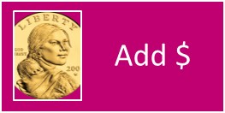
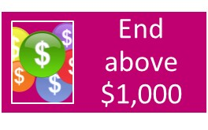

My Life My Choices
Using the Cash Flow Register
Notes:
Hold up a sample cash flow register and point to where they will add money they receive or earn (under the + column) and to where they will subtract money they have to spend (under the – column)

Slide 6

FINAL NOTE before Starting
Emergency Savings = WILD CARD
Emergency Savings
Any time
Any expense of your choice
But ONLY ONCE
Notes:
If the student chose the Emergency Savings card, it acts like a one-time WILD CARD.
The student may use it at any time
The Emergency Savings card will offset any expense of his or her choice (so he or she does NOT have to make the extra payment)
But he or she may ONLY use it ONCE

Slide 7
Day 1 (1st Line)
What’s Happening:
Rent
Rent is Due!
Consequences:
WITH the Card
WITHOUT the Card
$0
- $500
$0
$1,000
$500
$500
Notes:
Possible discussion of survival needs vs. wants: “What do you notice about the three expenses listed for Day One?” (all are physical survival expenses)
= = = = = = = = =
“Did you make sure that you included rent in your budget? If you have the Rent Card, you do not have pay anything extra.”
“If you forgot the Rent Card, you will not have time to look around for an affordable apartment. Pay an additional $500.”

Slide 8

Day 1 (2nd Line)
What’s Happening:
Groceries
You are hungry. You need to eat.
Consequences:
WITH the Card
WITHOUT the Card
$0
- $500
$0
$
$500
$
Notes:
Possible discussion:
The average American spends between $150 and $200 each month on groceries (does not include dining out).
The difference in cost between eating at a high school cafeteria (subsidized by the government) and a college/university cafeteria (much more expensive)
= = = = = = = = =
“If you did not have Groceries Card among your priorities, you are now on the school’s cafeteria plan”
This includes 3 meals a day
Food is basically all-you-can-eat
“Subtract $500.”
NOTE: Shopping and cooking for yourself might be around $200 a month.

Slide 9
Day 1 (3rd Line)
Thrift Store
What’s Happening:
You need some clothing.
Brand Name
Consequences:
WITH EITHER Card
WITHOUT either Card
$0
- $25
$0
$
Thrift Store
$25
$
Notes:
Discussion: Some young people heading off on their own assume that, since they have a closet full of clothing and shoes, they won’t need a clothing budget. This is not the case for various reasons:
You may be moving to a place with very different weather, requiring you to purchase heavier coats or lighter jackets
Your new living situation may require you to walk more, meaning you will need better walking shoes
Your new job might require clothing and footwear you do not currently own
Clothing eventually wears out and needs to be replaced
You may gain or lose weight and no longer fit into your clothing comfortably
= = = = = = = = =
“As long as you had at least one of the two possible clothing cards, you have budgeted for clothing and will not need to spend any additional money.”
“If you did not have a clothing card, you default to ‘Thrift Store’ shopping. Spend an extra $25.”
Ask the students to write which type of clothing he or she chose by noting it on the line after “Clothing.” Either “Brand” or “Thrift.” If the student chose both cards, ask them to write “Both.”

Slide 10

Day 2
What’s Happening:
Entertainment
You just met someone special for your EPIC Homecoming Date!
Consequences:
WITH the Card
WITHOUT the Card
$0
- $100
$0
$
$100
$
Notes:
Possible Discussion:
Video games and Netflix, in spite of what a few students might believe, do not make for an EPIC date.
$100 is pretty minimal for a great date.
Movies with food and a drink will run about $50
Dinner out at a nice restaurant will run $50 or more
Be careful not to overdue such occasions. As of 2018, the average high school student spent more than $800 on prom. That is a lot of money for a day with someone, according to statistics, you have anywhere from just 2% to 14% chance of still dating or marrying after high school
It is also worth noting, for students who are in love with the idea of being in love, that only 19% of people who marry their high school sweetheart end up going to college. Compare that to the average of 66% (2018) of all high school graduates who enroll in college.
= = = = = = = = =
“If you had the entertainment card, you do not have to pay an extra.”
“If you did not choose the entertainment card, you must subtract $100 on this line.”

Slide 11

Day 5
What’s Happening:
Car or Truck
Let’s get you to work.
Consequences:
WITH the Card
WITHOUT the Card
- $25
$25
$
Notes:
When discussing taking a car or truck to college, keep the following in mind:
“It is more expensive to OWN a car than to BUY a car” (Todd Christensen, Debt Reduction Services, Inc.)
Taking into account insurance, maintenance (oil, tires, filters) and repairs, gasoline and parking, most students would spend far more a year on using and fixing their vehicle than what they bought it for.
Recommendation: Don’t go to college with a car or truck loan. Borrow a family member’s car or truck or use public transportation.
College students do not earn much money as it is. A car or truck payment will drain their bank account of funds needed for basic living expenses
Do NOT use student loan funds to purchase a car or make a down payment on one. Besides being prohibited by the lender, it is typically a bad financial move.
= = = = = = = = =
“If you chose NOT to have a car or truck, you will be using public transportation (bus, subways), ride sharing, a bicycle or your feet. Subtract $25 for a bus pass or extra bike gear.”
Fun terms for walking include:
Take the “ChevroLegs”
Sweet ride. I love your LamberFeeti
Nice EscaLeg
I like your new Legsus
Sporty FootRari
You can take your ShoeBaru anywhere
El Patomobile (similar idea in Spanish)
BMW-Bike March or Walk
Foot Rover
GMC-Go March or Cycle
Land Runner
Leg Rover
Maserfeeti
Mitshoebishi
Model F (for feet)
Strutmobile

Slide 12
Day 5
What’s Happening:
Car or Truck
Let’s get you to work.
Car Maintenance
Consequences:
WITH BOTH Cards
WITHOUT 2nd Card
$0
- $500
$0
$
$500
$
Notes:
Possible discussions:
Without maintaining your vehicle, it will not last long. You will need to pay for regular maintenance that includes:
Oil changes
Air filters
Wiper Blades
Tires
Brake pads
Tune ups
= = = = = = = = =
If you chose the Car/Truck card but not the Maintenance card, your vehicle does not start this morning. Subtract $500 to have it towed to the mechanic, plus the mechanic’s labor and the parts to fix it.”

Slide 13
Day 6
What’s Happening:
Car or Truck
Time to go shopping
Consequences:
WITH the Card
WITHOUT the Card
$0
$0
$
Notes:
Those without a car or truck can take a bus, shuttle or walk to the store.

Slide 14
Day 6
What’s Happening:
Car or Truck
Time to go shopping
Gasoline
Consequences:
WITH BOTH Cards
WITHOUT 2nd Card
$0
- $100
$0
$
$100
$
Notes:
Without gasoline, your car or truck don’t do you any good.
Average monthly gasoline costs for average drivers (1,000 miles per month) are (2018 - $3.50 per gallon):
Large SUV (15 MPG): $230
Large Truck (18 MPG): $200
Minivan (20 MPG): $175
Small Truck (22 MPG): $160
Large Sedan (25 MPG): $140
Small SUV (28 MPG): $125
Subcompact (35 MPG): $100
Hybrid (45 MPG): $75

Slide 15

Day 7
What’s Happening:
Giving Gifts
Happy Birthday!
Consequences:
WITH the Card
WITHOUT the Card
+$200
+$50
$200
$
$50
$
Notes:
Principles for this screen include:
What goes around comes around
Karma
Cast your bread upon the water (for you will find it after many days – Bible)
If you are generous with others, they tend to be generous with you.

Slide 16
Day 8
What’s Happening:
Overate and think a DIET might be a doubly good idea
Consequences:
EVERYONE
+$50
$50
$
Notes:
You are worried that if you don’t cut back on eating, you will gain unhealthy weight and/or become unhealthy.
By eating less (dieting), you think you will both lose weight and spend less on food.

Slide 17
Day 9
What’s Happening:
Dining Out
You are STARVING after 36 hours on the diet. Its BUFFET time!
Consequences:
WITH the Card
WITHOUT the Card
-$25
- $75
$25
$
$75
$
Notes:
If you can go “on” a diet, you WILL come “off” the diet. Coming off a diet, most people gain back all of their lost weight, and then some.
The best thing to do for your health is to eat good food in moderation and stay physically active.
Most people do not enjoy going out to eat by themselves, so you invite your roommates. However, they already spent all of their fun money on your birthday. So you offer to pay for their meals.
While it is good to plan some money for dining out, do not go crazy. Anytime you pay someone to do something for you that you could do yourself, you will spend much more (e.g. dining out, car wash, lawn care, etc.)

Slide 18

Day 10
What’s Happening:
Healthcare
That buffet made you SICK! Can you say, “ER?”
Consequences:
WITH the Card
WITHOUT the Card
-$50
- $300
$50
$
$300
$
Notes:
If you have health insurance, you pay a monthly premium (unless your employer pays the whole thing). Even with insurance coverage, you still need to pay each time you visit the doctor (it’s called a co-pay). ER visits have the highest co-pays, much higher than Urgent Care and your family doctor.

Slide 19
Day 11
What’s Happening:
Tax refund from your summer job!
Consequences:
EVERYONE
+$200
$200
$
Notes:
Possible Discussion:
Filling out the I-9 form when hired. The more exemptions you claim (1 for yourself, 1 for a spouse, 1 for each child, etc.), the less income tax the government will take from your paycheck.
= = = = = = = = =
“Apparently, you didn’t make enough last summer to pay any income tax. You are getting it all back!”

Slide 20
Day 14
What’s Happening:
Cell Phone
Need to figure out times, colors, food with new boy/girl friend
Consequences:
WITH the Card
WITHOUT the Card
$0
- $100
$0
$
$100
$
Notes:
Possible Discussion:
Staying on Mom or Dad’s phone plan, if possible, will likely save you more than 50% over having a plan on your own.
Three is a huge difference between cell phone service providers. The largest cell phone company often charges 100% more than what you would pay through the #3 or #4 provider.
= = = = = = = = =
“Your new boy/girl friend went home for the weekend and wants to discuss where you are going on your big date, when and where you are meeting, and if you should coordinate your colors. If you chose the Cell Phone card, you do not have to pay anything extra.”
“If you did not choose the Cell Phone card, pay an extra $100 for a handset and a pay-as-you-go service.”

Slide 21
Day 15
What’s Happening:
Payday!!!
Consequences:
EVERYONE
+$500
$500
$
Notes:
Possible discussion:
The typical college student in 2018 received about $350 of support per month from his or her family.
The typical college student in 2018 earned around $400 each month from a part-time job.

Slide 22
Day 17
What’s Happening:
Utilities
Utility bills were due 2 weeks ago!
Consequences:
WITH the Card
WITHOUT the Card
$0
- $100
$0
$
$100
$
Notes:
= = = = = = = = =
“If you chose the Utilities card, you wake up as normal and head off to work without thinking about the light bill.”
“If you did not choose the Utilities card, the electricity was cut off, your phone died, and your alarm clock did not go off. Pay an extra $100 to get the lights back on.”

Slide 23
Day 18
What’s Happening:
Car or Truck
A tow truck was spotted near your apartment late last night?
Consequences:
WITHOUT the Card
$0
$0
$

Slide 24

Day 18
What’s Happening:
Car or Truck
A tow truck was spotted near your apartment late last night?
Parking Permit
Consequences:
WITH BOTH Cards
WITHOUT 2nd Card
$0
- $100
$0
$
$100
$

Slide 25

Day 20
What’s Happening:
A Dog or Cat
Pet gets sick and needs a veterinarian
Consequences:
WITH the Card
WITHOUT the Card
-$200
$0
$200
$
$0
$

Slide 26
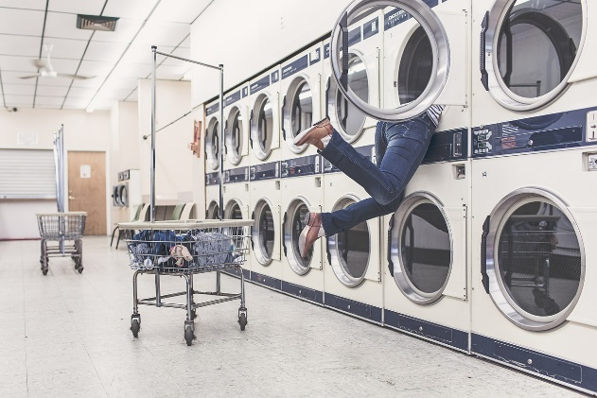
Day 22
What’s Happening:
Laundromat
Dirty pile of disgusting clothes under your bed – WASH DAY!
Consequences:
WITH the Card
WITHOUT the Card
$0
- $100
$0
$
$100
$

Slide 27
Day 23
What’s Happening:
Chocolate, Candy, Energy Drinks
Everyone has healthcare now. But they give discount for healthy eating
Consequences:
WITH the Card
WITHOUT the Card
$0
+$50
$0
$
$50
$

Slide 28

Day 25
What’s Happening:
Renters Insurance
Back from road trip, you find your apartment FLOODED!
Consequences:
WITH the Card
WITHOUT the Card
$0
$0
$

Slide 29
Day 25
Thrift Store Clothing
What’s Happening:
Back from road trip, you find your apartment FLOODED!
Brand Name Clothing
Consequences:
WITH THIFT Card
WITH Brand Name Card
-$200
- $1,000
$200
$
$1,000
$

Slide 30
Day 28
What’s Happening:
Car or Truck
Vehicle insurance is due
Consequences:
WITHOUT the Card
$0
$0
$

Slide 31
Day 28
What’s Happening:
Car or Truck
Vehicle insurance is due
Car Insurance
Consequences:
WITH BOTH Cards
WITHOUT 2nd Card
$0
- $200
$0
$
$200
$

Slide 32
Day 31
What’s Happening:
Emergency Savings
Company is DOWNSIZING your entire department. You have lost your job.
Consequences:
WITH the Card
WITHOUT the Card
$0
- $1,000
$0
$
$1,000
$

Slide 33
End of Month
What’s Happening:
Did you go below $0 at ANY time? You are hit with OVERDRAFT fee
Consequences:
EVERYONE who Has
-$50
$50
$

Slide 34

My Life My Choices
Above $1,000?
Most surprising?
Most painful?
What would you do DIFFERENTLY in real life?
Notes:
Allow the students to answer these and related questions. Others might include:
Who ended up below $0?
Who ended with the most money left over? The most in debt?
Which card was the most difficult to choose?
Which card was the easiest to choose?
What would you do the same next time?

Slide 35

My Life My Choices
Thank you for your participation!

